Slide 1
Scholarly
Final Presentation
Spring 2026

Slide 2





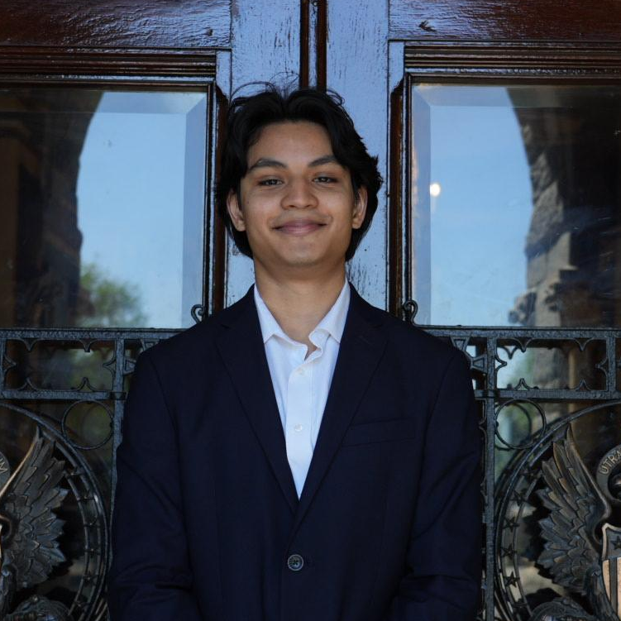


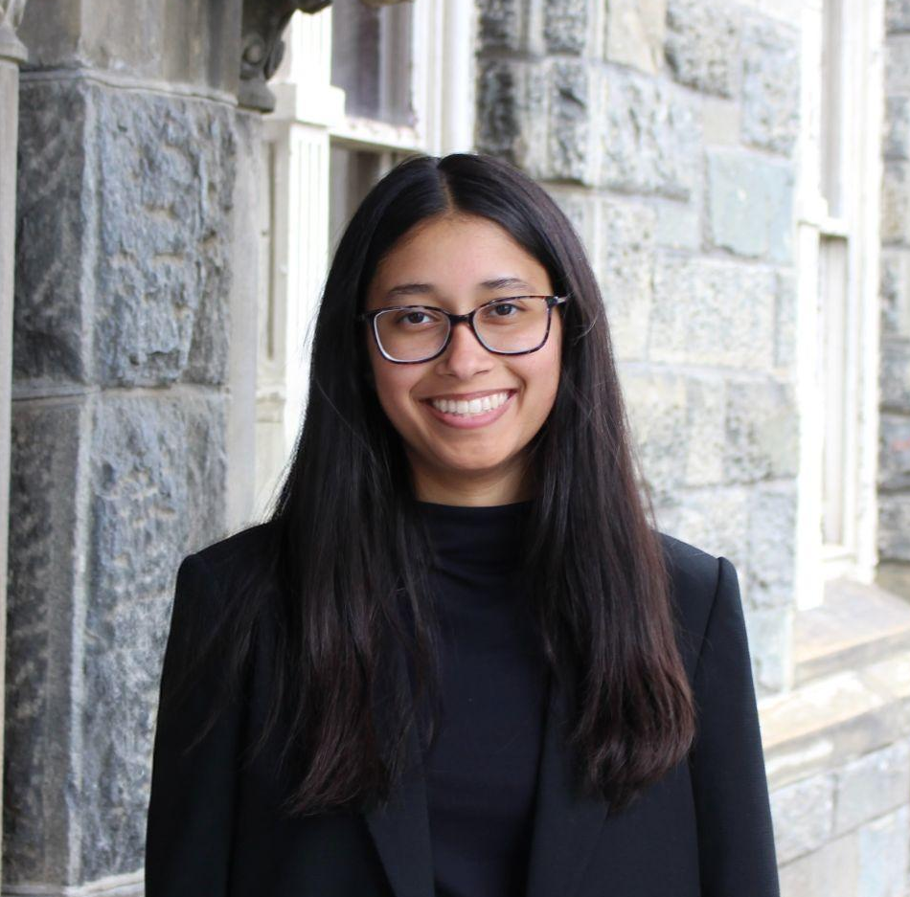
Meet the Team
Ella Hong
Jesse Najera
Isabella Delach
Anika Lippke
Catalin Wong
Zarin Rizvi
Aniya Jain

Slide 3
Agenda
01 Overview
02 Admin Dashboard - Pain Points & Solution
03 Parent Dashboard - Pain Points & Solution
04 Bringing It Together

Slide 4
Overview
01
Introduction of Client, The Ask, Project Scope

Slide 5

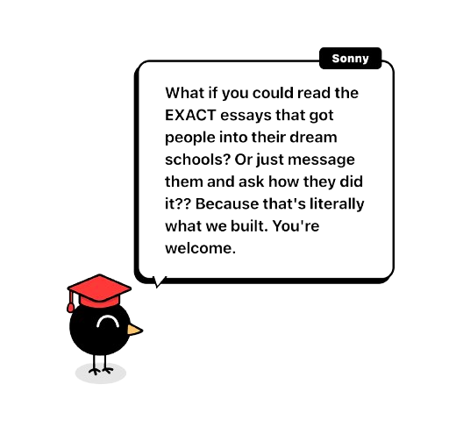
Introduction of Scholarly
Gamified platform designed to help guide high school students in the college application process
Personality test to match students with colleges
Case studies from college students
Messaging feature
More

Slide 6
The Ask
Discovery & Requirements Brief
High-Fidelity Figma Design
Core Flows for Admin + Parent

Slide 7








Project Scope
Competitor Analysis
Design Brief
Final Design
Pain Points
Key Features
Success Criteria
High-Fidelity Figma
Admin + Parent Flows
Core Inspiration
College Admissions
User Research
PRD
User Stories
What’s In / What’s Out
Risks & Open Questions
Surveys
Interviews
Notes:
cat

Slide 8
Admin dashboard
02
Pain point & the solutions we built
Notes:
Aniya
First deliverable was mock-ups of admin dashboard (school counselors, privately-hired counselors)

Slide 9
Roster View Dashboard + Task and Milestone Tracker
PAIN POINT
Information overload across multiple students
RESEARCH
SOLUTION
OUTCOME
Competitors, like Common App, Scoir, and Naviance only organize tasks by student
Aggregated dashboard view organized by task and deadline
Scholarly is more intuitive for counselors, tasks are completed efficiently, and students are more satisfied
Notes:
Aniya
Pain point identified was information overload across students
Competitive analysis showed that platforms like common app and naviance were unable to solve this issue, and all information was organized by student, not by deadline or priority
Our mock-up fixes this by allowing admins to sort by both student and by priority
Allows counselors to be more efficient with their time and students more satisfied

Slide 10
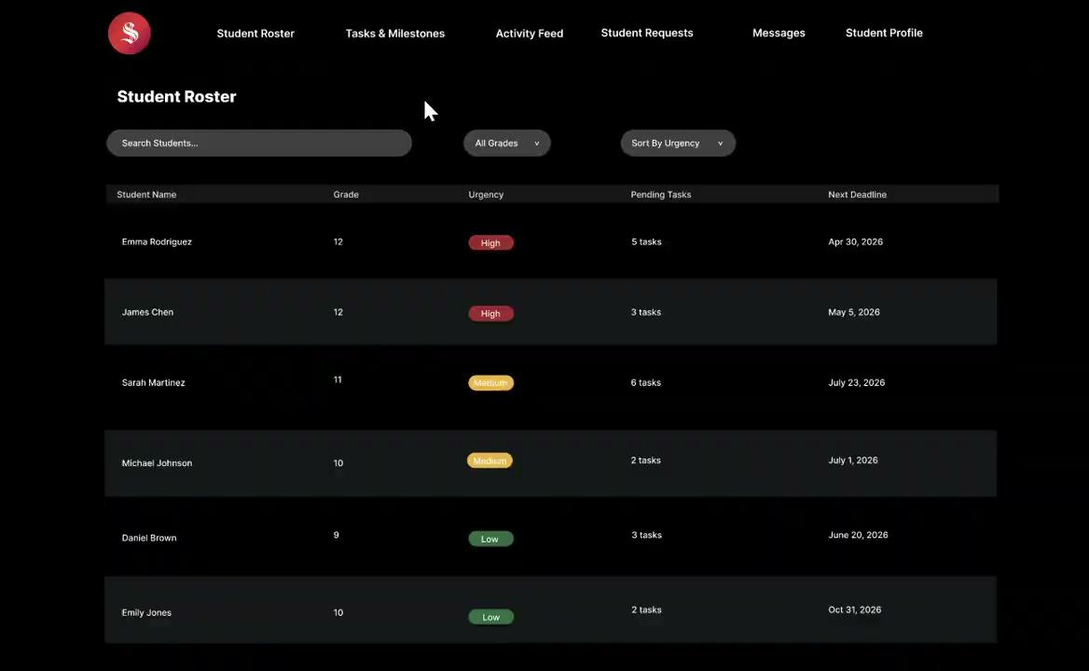
Roster View + Task and Milestone - Figma Mockup
Notes:
Aniya

Slide 11
Communications Threads
PAIN POINT
Counselors manage communication between students and parents across multiple platforms, leading to duplicated questions, missed updates, and extra follow-up for counselors.
RESEARCH
SOLUTION
OUTCOME
Competitors like Common App and Naviance lack integrated messaging for both parents and students
Counselors must manually track conversations across external platforms
Create dedicated communication threads separating student-counselor and parent-counselor interactions
Centralize all messages within the platform with clear visibility and history for each relationship
1.
1.
1.
Counselors stay aligned on all conversations without searching across platforms
Follow-ups are streamlined, reducing time spent on coordination
2.
2.
2.
Notes:
Zarin
Duolingo is a prime example of how gamification can be integrated to keep users engaged
Meanwhile, Khan Academy has a very structured, comprehensive approach to admissions guidance.
Scholarly takes the best of both models as an action-oriented system that turns guidance into concrete next steps, accountability, and measurable progress.

Slide 12
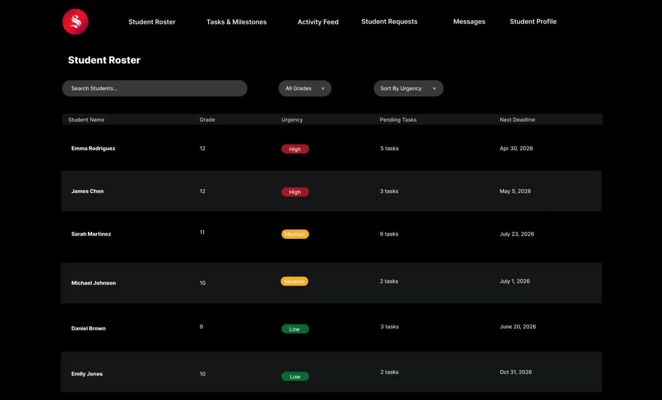
Communications Threads - Figma Mockup
Notes:
Zarin
Duolingo is a prime example of how gamification can be integrated to keep users engaged
Meanwhile, Khan Academy has a very structured, comprehensive approach to admissions guidance.
Scholarly takes the best of both models as an action-oriented system that turns guidance into concrete next steps, accountability, and measurable progress.

Slide 13
Student Requests + Flags
PAIN POINT
Inconsistent expectations for student autonomy & parent interference
There is a gap across competitor apps (Common App, Naviance) for limiting parent involvement whilst ensuring student self-sufficiency
Request dashboard which allows students to consult admin on how much to involve the parent
Scholarly hands students the wheel, making admin responsible for moderating parent access, acting as a neutral third party.
RESEARCH
SOLUTION
OUTCOME
Notes:
Anika
Duolingo is a prime example of how gamification can be integrated to keep users engaged
Meanwhile, Khan Academy has a very structured, comprehensive approach to admissions guidance.
Scholarly takes the best of both models as an action-oriented system that turns guidance into concrete next steps, accountability, and measurable progress.

Slide 14
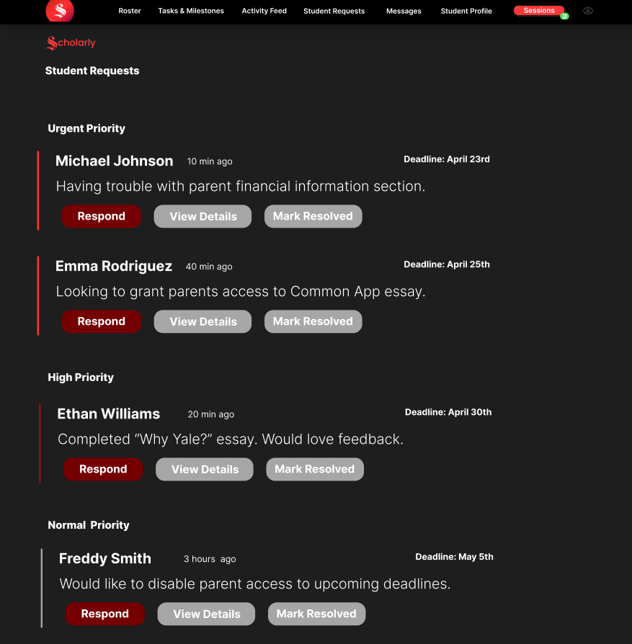
Student Requests + Flags - Figma Mockup
Notes:
Anika
Duolingo is a prime example of how gamification can be integrated to keep users engaged
Meanwhile, Khan Academy has a very structured, comprehensive approach to admissions guidance.
Scholarly takes the best of both models as an action-oriented system that turns guidance into concrete next steps, accountability, and measurable progress.

Slide 15
Parent dashboard
03
Pain point & the solutions we built

Slide 16
Progress Tracking + Parent Insight Layer
PAIN POINT
Parents seek basic progress tracking in students, who often do not take the initiative to tell their parents their work. Parents do not comprehensively know what needs to be completed for themselves or for their students.
RESEARCH
SOLUTION
OUTCOME
User Research
1.
Allow the parent to see student’s overall, brainstorming, housekeeping, and essay progress.
Inform parents what they must complete first and how long and how urgent it is to complete.
1.
Parents stay informed without relying on their student and get a view of progress across all stages.
Parents know exactly what they need to do and when.
1.
Timelines would reassure confidence in progress
Most parents find out about college information by request from their kids
2.
2.
2.
Notes:
Isabella
Duolingo is a prime example of how gamification can be integrated to keep users engaged
Meanwhile, Khan Academy has a very structured, comprehensive approach to admissions guidance.
Scholarly takes the best of both models as an action-oriented system that turns guidance into concrete next steps, accountability, and measurable progress.

Slide 17

Progress Tracking + Parent Insight - Figma Mockup
Notes:
Isabella
Duolingo is a prime example of how gamification can be integrated to keep users engaged
Meanwhile, Khan Academy has a very structured, comprehensive approach to admissions guidance.
Scholarly takes the best of both models as an action-oriented system that turns guidance into concrete next steps, accountability, and measurable progress.

Slide 18
Selective Visibility Controls
PAIN POINT
Parents seek visibility into student progress, while students prefer to maintain control over sensitive or early-stage work (e.g., rough essay drafts).
RESEARCH
SOLUTION
OUTCOME
1
2
Parents feel isolated and lacking in information about the application process
Students feel pressure from parents to reveal information, causing tension
1
2
Allow the student opportunities to select what information is shared with the parent.
Limit parents to a primarily observational role, with little to no ability to edit or modify content
1
2
Keep parents informed on student progress—on the student’s timing and terms
Expand transparency while preserving healthy boundaries and minimizing potential conflict
Notes:
Cat
Duolingo is a prime example of how gamification can be integrated to keep users engaged
Meanwhile, Khan Academy has a very structured, comprehensive approach to admissions guidance.
Scholarly takes the best of both models as an action-oriented system that turns guidance into concrete next steps, accountability, and measurable progress.

Slide 19
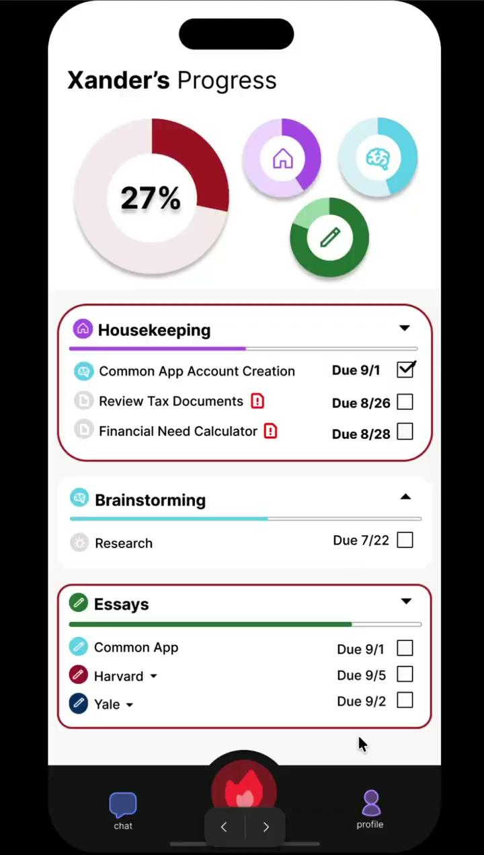
Selective Visibility Controls - Figma Mockup
Notes:
Cat
Duolingo is a prime example of how gamification can be integrated to keep users engaged
Meanwhile, Khan Academy has a very structured, comprehensive approach to admissions guidance.
Scholarly takes the best of both models as an action-oriented system that turns guidance into concrete next steps, accountability, and measurable progress.

Slide 20
Case Study Library
PAIN POINT
Parents lack clear examples of what successful applicants looks like, so their support becomes generic.
RESEARCH
SOLUTION
OUTCOME
1
2
Khan Academy uses student stories to build confidence, but lacks personalization to a student’s profile
Parents need modern admissions context because they feel out of date and want to provide specific help.
1
2
Recommend case studies based on the child’s profile attributes
Present relevant examples of successful applicants for parents to grasp strategy and acceptance criteria.
1
2
Enables parents to have supportive conversations grounded in similar student examples.
Increases dashboard value by providing admissions context, making the parent experience more actionable and less reactive.
Notes:
Jesse
Duolingo is a prime example of how gamification can be integrated to keep users engaged
Meanwhile, Khan Academy has a very structured, comprehensive approach to admissions guidance.
Scholarly takes the best of both models as an action-oriented system that turns guidance into concrete next steps, accountability, and measurable progress.

Slide 21
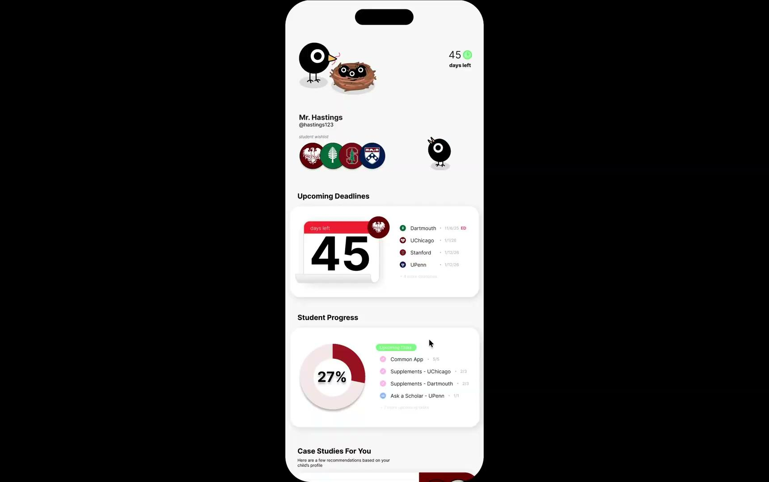
Case Study Library - Figma Mockup
Notes:
Jesse
Meanwhile, Khan Academy has a very structured, comprehensive approach to admissions guidance.
Scholarly takes the best of both models as an action-oriented system that turns guidance into concrete next steps, accountability, and measurable progress.

Slide 22
Bringing it together
04
Takeaways

Slide 23
Takeaways
Prioritize role-based visibility to balance transparency and control across users
1
Use gamification to drive action
2
Create stronger connections between roles to enable collaboration
3

Slide 24
Thank you!

